Slide 1
Intermolecular forces and properties
11 Chemistry

Slide 2
Learning goals
Explain the relationship between vapour pressure, melting point, boiling point and solubility, and the nature and strength of intermolecular forces (e.g. dispersion forces, dipole-dipole attractions, and hydrogen bonding) within molecular covalent substances.

Slide 3
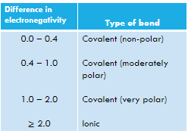
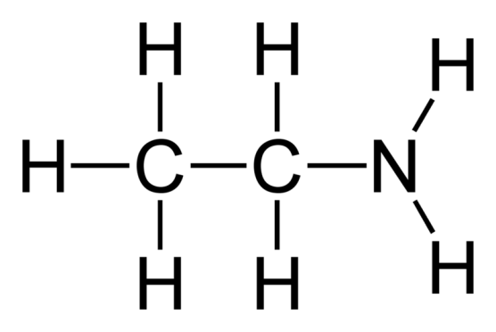
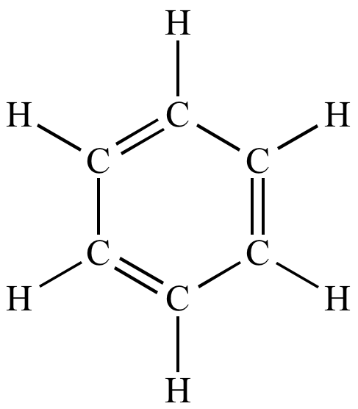
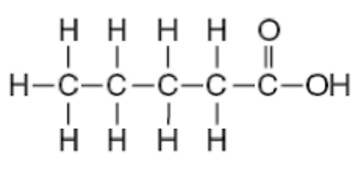
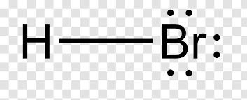
recap
On each compound below, circle the polar and non-polar sections. For any polar sections, label the positive and negative poles.
Data Book P 6
lol

Slide 4
Vocab List
Dispersion
London
Dipole
Polar
Hydrogen Bonding
Intramolecular
Intermolecular
Electrostatic
Dissolve
Solvent
Serenity
Hippopotamus

Slide 5
Reminder – intermolecular forces
Attractions between molecules
Weaker than intramolecular forces (ionic/covalent/metallic bonds)
Three types:
Dispersion forces / London dispersion forces / van der Waals forces
Dipole interactions
Hydrogen bonding
Increasing strength

Slide 6
Reminder – intermolecular forces
Type of Intermolecular Force | Affects | How it works
Dispersion forces | Every molecule | Attraction force between protons in one molecule and electrons in another molecule. Strength increases as molecular mass increases.
Dipole-dipole forces | Polar molecules | Polarity results in dipole moments where the partial positive pole of a molecule is attracted to the partial negative pole of another. Strength increases with polarity.
Hydrogen bonding | Polar molecules with an O-H, N-H, or F-H bond | A type of dipole-dipole force that is very strong. Results from high electronegativity difference between hydrogen and oxygen/nitrogen/fluorine.

Slide 7
Intermolecular forces and properties
Intermolecular forces are attractive forces that hold molecules together.
Intermolecular forces directly affect the properties of molecules. If the intermolecular forces are stronger, this will result in higher melting/boiling points and lower vapour pressure at STP.
Intermolecular forces also affect the solubility of molecules. A solute will not dissolve into a solvent unless the solute and solvent molecules experience attractive forces with each other (like dissolves like).

Slide 8
Melting and boiling points
For substances to melt or boil, molecules need to move away from each other.
The stronger the intermolecular forces between molecules, the more energy is required to force molecules apart.
Analogy – Tiarne is best friends with Chelsea (strong attractive force) and just likes Penelope as an acquaintance (weaker attractive force). It takes a lot of effort and energy to separate Tiarne and Chelsea (higher boiling point). It does not take as much energy to separate Tiarne and Penelope (lower boiling point).

Slide 9
Intermolecular forces and boiling points
As the intermolecular forces increase (are stronger), the melting/boiling point also increases.
To predict which molecules will have higher melting/boiling points, you need to determine the intermolecular forces experienced by different molecules and rank them in terms of strength.
Bigger molecules will have stronger intermolecular forces based on dispersion forces only.
Polar molecules will have stronger intermolecular forces than non-polar molecules because they experience dipole-dipole forces.

Slide 10
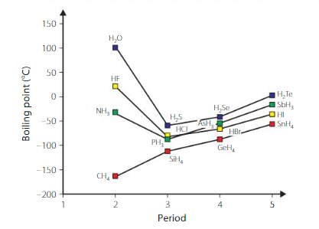
Hydrogen Bonding and boiling points
Look at the top series with purple squares (H₂O, H₂S, H₂Se, H₂Te).
The trends in boiling points can be explained using knowledge of intermolecular forces.
H₂O, H₂S, H₂Se, H₂Te are all polar molecules. Therefore they call experience dispersion forces and dipole-dipole forces.
H₂O also experiences hydrogen bonding which is the strongest intermolecular force. Therefore, H₂O has the highest boiling point.
The trend in boiling point for H₂S, H₂Se, and H₂Te can be explained by differences in dispersion forces. H₂Te has the highest molecular mass, therefore experiences the strongest dispersion force and has the next highest boiling point in the series.

Slide 11
Hydrogen Bonding and boiling points
Check for understanding:
Explain the trend in boiling point shown for the series with green squares (NH₃, PH₃, AsH₃, and SbH₃).
Refer to the shape of molecules (VSEPR), polarity, and intermolecular forces in your response.

Slide 12
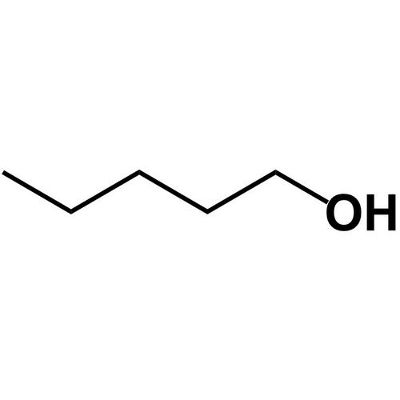
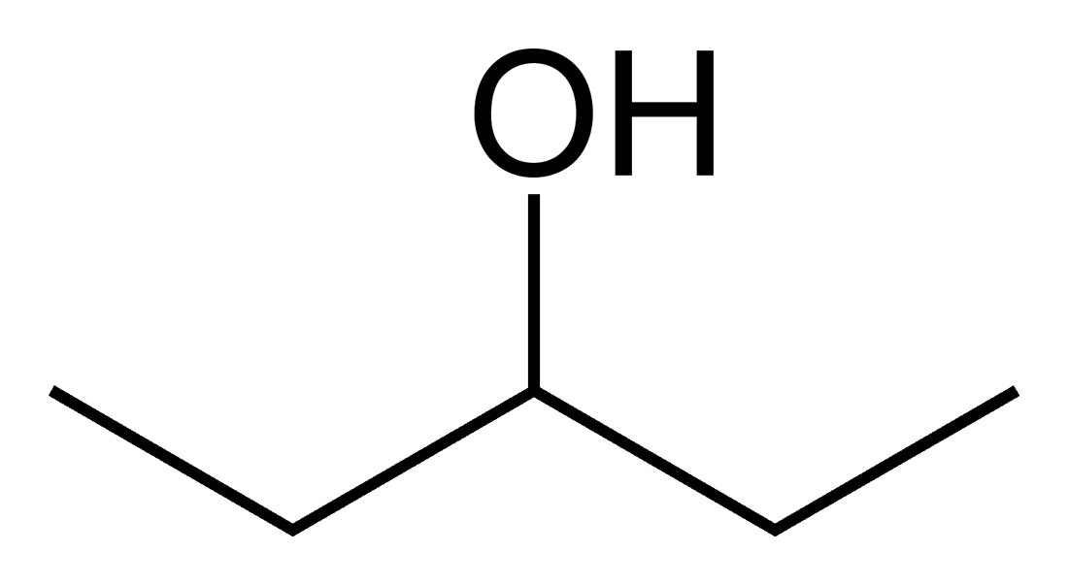
Intermolecular forces and boiling points
Also look at the shape of the molecule. If molecules have the same type of intermolecular forces and the same molecular mass, you can look at how well the molecules pack together (kind of like tetris). If molecules can get closer to each other, based on their geometry, they will have higher melting/boiling points compared to molecules that are unable to get close to each other.
My OH group is not in the way. I can get close to other molecules. My melting/boiling points are higher.
I have an OH group in the way. I won’t stack well. My melting/boiling points are lower.

Slide 13
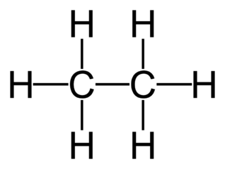
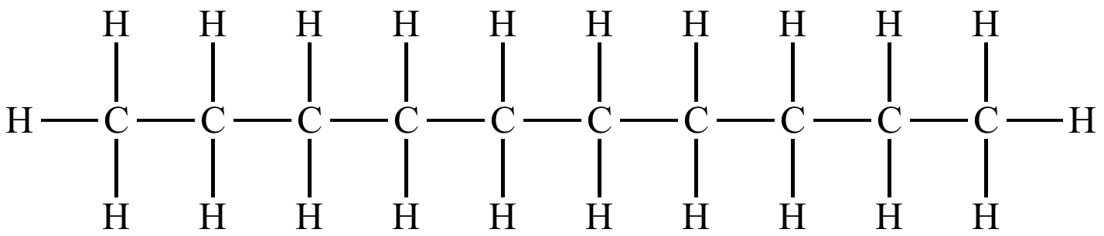
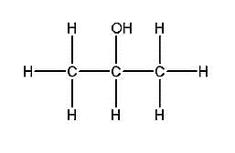
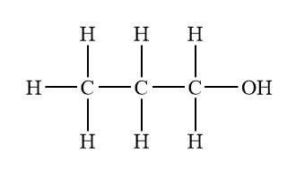
Intermolecular forces and boiling points
Predict which of the following molecule from each pair would have the highest melting / boiling point.
Refer to the shape of molecules (VSEPR), polarity, and intermolecular forces in your response.
(a)
or
(b)
or

Slide 14
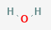
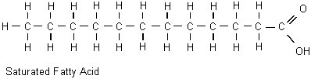
solubility
Solutes will only dissolve in a solvent if they experience the same/similar intermolecular forces.
Remember: Like dissolves like
For example, look at oil and water.
Water is polar and experiences hydrogen bonding, dipole-dipole forces, and dispersion forces.
Most of an oil molecule is non-polar, therefore experiences dispersion forces only.

Slide 15
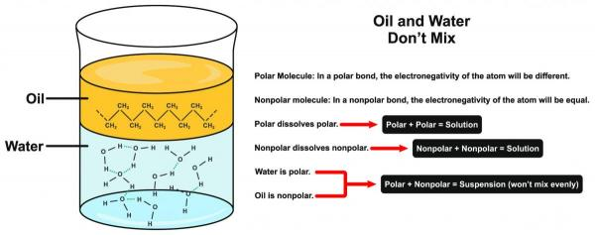
solubility
In the case of oil and water, water is more attracted to other water molecules, so will ‘push’ the oil molecules out.
Oil molecules are more attracted to other oil molecules than they are to water, so will not mix with the water.
We therefore see separation between oil and water, resulting in oil being insoluble in water.

Slide 16
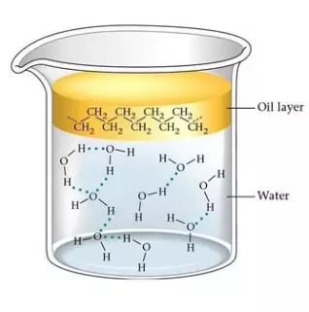
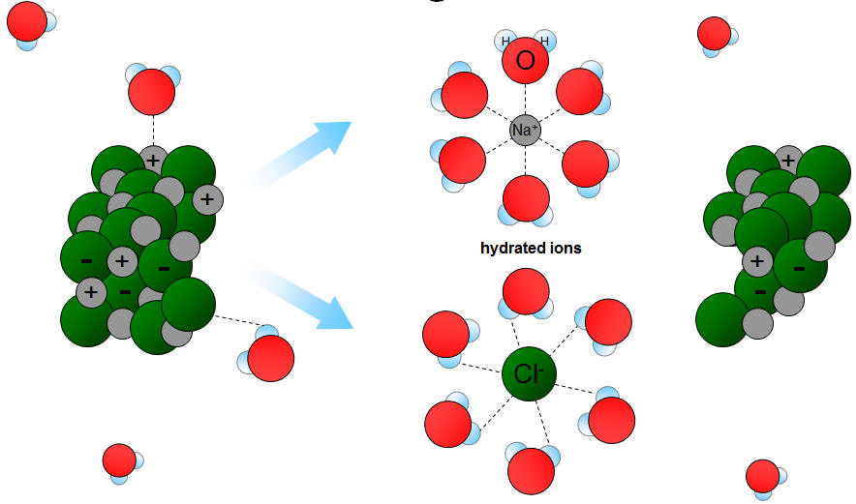
Like Attracts Like
These intermolecular forces play an incredibly significant role in intermolecular interactions (particularly when looking at polar and non-polar molecules)
Notes:
Water not dissolving a stain? Try something non-polar!

Slide 17
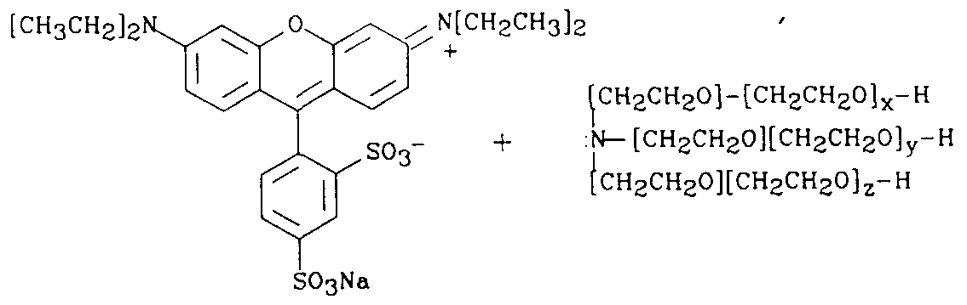
Like Dissolves Like
This is why I use hand sanitiser to help dissolve the whiteboard markers

Slide 18
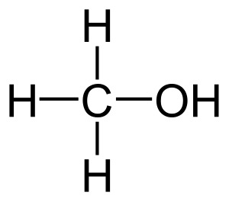
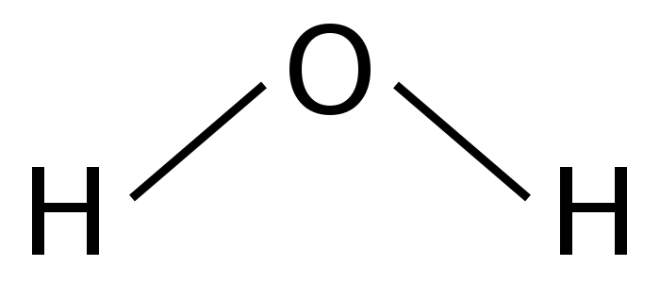
Like Dissolves Like
This is why acetone/methylated spirits can dissolve permanent markers, but water cannot

Slide 19
solubility
Predict whether the following solutes are soluble in their paired solvents. You will need to look up the chemical structure of each molecule.
Solute | Solvent | Soluble or not soluble?
Ethanol | Water
Ethanol | Hexane
Ammonia | Water

Slide 20
Vapour pressure
Vapour pressure is the pressure exerted by a vapour in equilibrium with its liquid form.
At room temperature, most liquids will ‘evaporate’ to an extent. If you put this in a closed container, you can measure the pressure of the vapour (it will stop increasing at some point) – this is the vapour pressure.
Molecules with stronger intermolecular forces will have a lower vapour pressure than molecules that experience weaker intermolecular forces. This is why there is such a strong smell at the petrol station – intermolecular forces between molecules in petrol are weak. You are smelling the evaporated gas from the petrol, which happens because molecules are not strongly held together.
An opposite example is water, which has a much lower vapour pressure because it experiences strong intermolecular forces. It requires a lot of energy to separate water molecules to get them from a liquid to a gas.

